Slide 1
Neural Networks

Slide 2
Human Brain
Computers and the Brain: A Contrast
  Arithmetic: 1 brain = 1/10 pocket calculator
  Vision: 1 brain = 1000 super computers
  Memory of arbitrary details: computer wins
  Memory of real-world facts: brain wins
  A computer must be programmed explicitly
  The brain can learn by experiencing the world

Slide 3
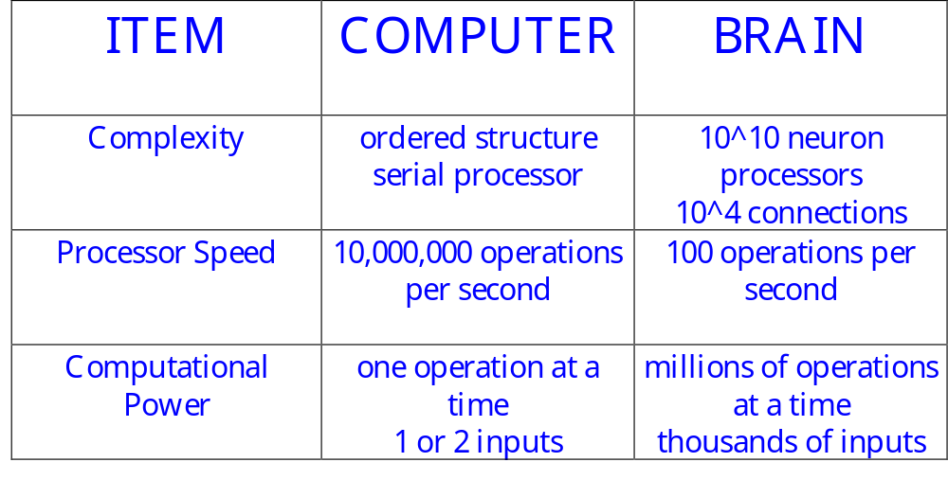
Other Comparisons

Slide 4
Computer Operations
Traditionally computers execute a sequence of instructions to accomplish a set task
    This is a powerful technique if you know the ‘algorithm’
    It’s not very useful if you don’t !!
There are many interesting tasks where the algorithm is either unknown or unclear
    Recognizing handwriting - Pattern recognition
    Playing table tennis - Interacting with the environment
    Balancing activities - Optimization

Slide 5

The Question
  Humans find these tasks relatively simple
    We learn by example
    The brain is responsible for our ‘computing’ power
If a machine were constructed using the fundamental building blocks found in the brain could it learn to do ‘difficult’ tasks ???

Slide 6
Definition
“. . . Neural nets are basically mathematical models of information processing . . .”
“. . . (neural nets) refer to machines that have a structure that, at some level, reflects what is known of the structure of the brain . . .”
“A neural network is a massively parallel distributed processor . . . “

Slide 7
Neural Net Concept
Artificial Neural Systems are called:
  neurocomputers
  neural networks
  parallel distributed processors
  connectionists systems
Basic Philosophy
  large number of simple “neuron-like” processors which execute global or distributed computation

Slide 8
Neural Nets vs Standard Computing
NN are different from
  Parallel Processors - if you look at one processor in a typical parallel system, its work makes sense
  Contemporary AI – no algorithms

Slide 9
Processing Comparisons
INPUT
(Type)
OUTPUT
(Procedural)
Data Input
Conventional Processing
Procedures applied to data
Data Output
1, 2, 3, etc.
(Logical)
Facts
Expert/Knowledge-Based System
Inference Engine & Knowledge (Rules)
Decision Recommend
(A is True)
(Statistical)
Patterns
Neural Networks
Network Algorithm Identifies Patterns
Pattern recognized
Shashidhar Ram Joshi

Slide 10
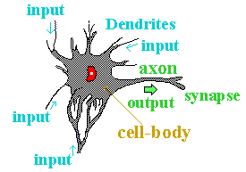
Biological Neurons
A neuron consists of two main parts:
  Axon
    one per neuron
    excites up to 10⁴ other neurons
    all or nothing output signal
  Dendrites
    1 to 10⁴ per neuron

Slide 11
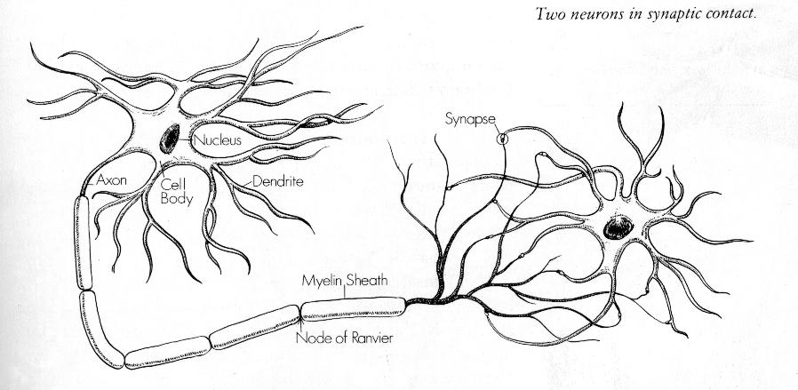
Two Neurons

Slide 12
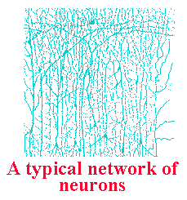
Properties of the Brain
Architectural
  80,000 neurons per square mm
  10¹¹ neurons - 10¹⁵ connections
  Most axons extend less than 1 mm (local connections)
Operational
  Highly complex, nonlinear,
  parallel computer
  Operates at millisecond speeds

Slide 13
Interconnectedness
Each neuron may have over a thousand synapses
Some cells in cerebral cortex may have 200,000 connections
Total number of connections in the brain “network” is astronomical—greater than the number of particles in known universe

Slide 14
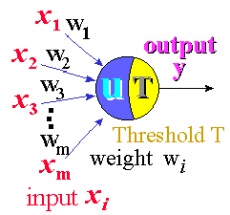
Artificial Neuron
An artificial neuron is designed to mimic the first-order characteristics of a biological neuron
A set of inputs, x_{i}
Each input is multiplied
by the corresponding
weight, w_{i}
All of the weighted inputs
are summed to determine
the activation level
An activation function is applied to determine
the neuron output

Slide 15

Mathematical Structure
A neuron is a simple sum and compare device
u = x₁w₁ + x₂w₂ + . . . x_{n}w_{n} - T
y = f(u)
threshold
One possible function for y is a step function:
If the weighted sum of the inputs is greater
than the threshold, then the neuron “fires”

